Slide 1
Basic data type in C programming

Slide 2
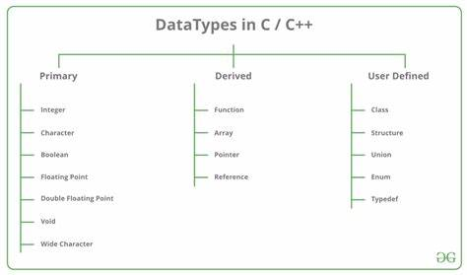
In C programming, basic data types are the fundamental building blocks used to define variables.

Slide 3
int: Used to store integer values. For example: int age = 25; float: Used to store floating-point (decimal) values. For example: float salary = 3500.50; double: Similar to float but with double precision, allowing for a greater range and more significant digits. For example: double pi = 3.141592653589793; char: Used to store a single character. For example: char grade = 'A'; _Bool: Used to store Boolean values (true or false). In C, 0 represents false, and any non-zero value represents true. For example: _Bool isStudent = 1; // true
Overview of Basic Data Types
#include <stdio.h>
int main() {
int age = 25;
float salary = 3500.50;
double pi = 3.141592653589793;
char grade = 'A';
_Bool isStudent = 1;
printf("Age: %d\n", age);
printf("Salary: %.2f\n", salary);
printf("PI: %f\n", pi);
printf("Grade: %c\n", grade);
printf("Is student? %d\n", isStudent);
return 0;
}

Slide 4
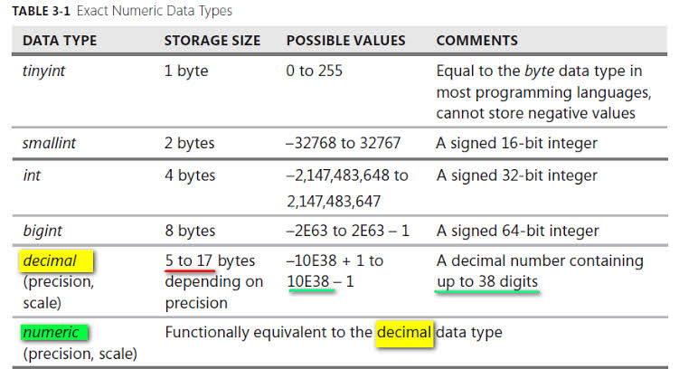

Slide 5
Modifiers and Qualifiers
Modifiers:
short:
Example: short int num = 10;
Explanation: "Reduces the size of the data type, typically used to save memory when a smaller range of values is sufficient."
long:
Example: long int largeNum = 1000000;
Explanation: "Increases the size of the data type, allowing for a larger range of values."
Qualifiers:
unsigned:
Example: unsigned int positiveNum = 20;
Explanation: "Specifies that the variable will only store non-negative values, effectively doubling the positive range."

